Slide 1
Mathematics (9-1) - iGCSE
2018-20
Year 09
Unit 06 – Answers

Slide 2
6 - Prior knowledge check
Page 643
a. 21 b. -22
a. y b. 4 c. -$\frac{1}{3}$ d. -$\frac{5}{2}$
5 km/h
a. 9 b. 7 c. $\frac{1}{5}$ d. 25 e. 125
a. $\frac{4}{3}$ b. 3
A: y = 3, B: x = -3, C: y = x, D: y = -x

Slide 3
6 - Prior knowledge check
Page 643
a. b. Students' graph of 2x + 1
a. i. 3 ii. -1 b. i. $\frac{1}{2}$ ii. 2 c. i. -1 ii. 1
a. i. £55 ii. £140 b. i. £50 ii. 45 minutes iii. £20 per hour 10 (-1,3) and (3,11)
x | -3 | -2 | -1 | 0 | 1 | 2 | 3
y | -5 | -3 | -1 | 1 | 3 | 5 | 7

Slide 4
6.1 – Linear Graphs
Page 643
y = 2x - 5
a. Any line with gradient = 5
Any line with gradient = 0.5
Any line with gradient = -3
Equation of line | Gradient | y-intercept
y = 2x + 4 | 2 | 4
y = 2x | 2 | 0
y = 2x – 3 | 2 | -3

Slide 5
6.1 – Linear Graphs
Page 643
y = 2x - 5
a. Any line with gradient = 5
Any line with gradient = 0.5
Any line with gradient = -3
a. A:y - 2x - 2, B:y = 3x + 1, C: y = 2x + 1 D: y = -x
D c. B d. Band C e. A and C
Equation of line | Gradient | y-intercept
y = 2x + 4 | 2 | 4
y = 2x | 2 | 0
y = 2x – 3 | 2 | -3

Slide 6
6.1 – Linear Graphs
Page 643
A: y = 2x, B: y = 3x - 4, C: y = $\frac{1}{2}$x + 2, D: y = -x - 1, E: y = 2x + 2, F: y = x – 1
a. ii and iv b. i and iv

Slide 7
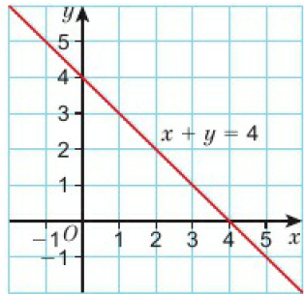
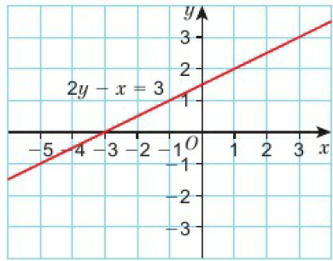
6.1 – Linear Graphs
Page 643
a. i. b. i. ii. ii.
x | 0 | -3
y | 1$\frac{1}{2}$ | 0
x | 0 | 4
y | 4 | 0

Slide 8
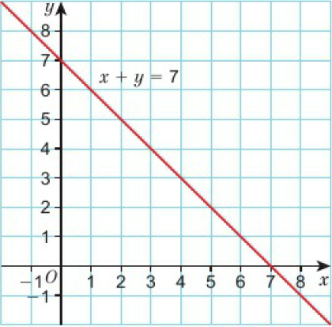
6.1 – Linear Graphs
Page 644
c. i. ii.
x | 0 | 7
y | 7 | 0

Slide 9
6.1 – Linear Graphs
Page 644
a. y = $\frac{3+x}{2}$; y = 4 – x; y = 7 - x
Gradient $\frac{1}{2}$, y-intercept $\frac{3}{2}$, gradient -1, y-intercept 4; gradient -1, y-intercept 7
Students' own check 9 Line c is steepest.
Line c is steepest
B and E

Slide 10
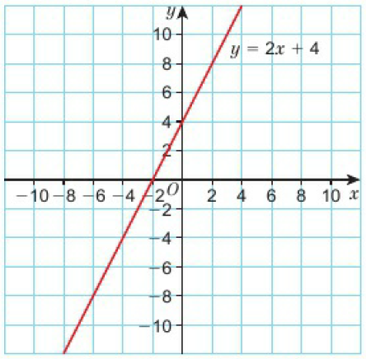
6.2 – More Linear Graphs
Page 644
A:y = 2x + 2, B: - $\frac{1}{3}$x - 1. C: y = -2x + 1
c = 3
a.

Slide 11
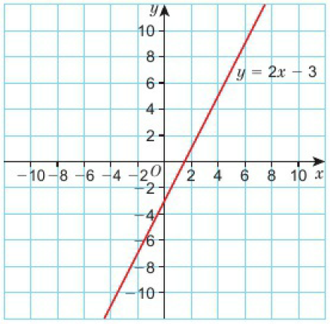
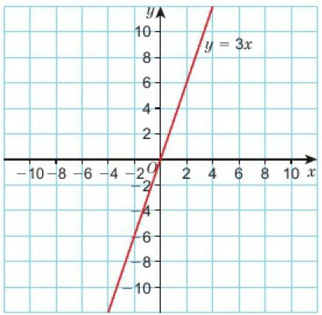
6.2 – More Linear Graphs
Page 644
b. c.

Slide 12
6.2 – More Linear Graphs
Page 644
d.

Slide 13
6.2 – More Linear Graphs
Page 645
e. f.

Slide 14
6.2 – More Linear Graphs
Page 645
A:y = $\frac{1}{2}$x + 3, B: y = -x + 4, C: y = 2x + 3, D: y = 5x + 1
a. Sketch graph of y = 2x b. Sketch graph of y = 3x + 1 c. Sketch graph of x + y = 5
a. i. x-intercept = 3, y-intercept = 3
x-intercept = -2, y-intercept = -6
x-intercept = -2 , y-intercept = 2
x-intercept = -2, y-intercept = 4
Students’ own answers.

Slide 15
6.2 – More Linear Graphs
Page 645
A:y = $\frac{1}{2}$x + 3, B: y = -x + 4, C: y = 2x + 3, D: y = 5x + 1
a. Sketch graph of y = 2x b. Sketch graph of y = 3x + 1 c. Sketch graph of x + y = 5
a. i. x-intercept = 3, y-intercept = 3
x-intercept = -2, y-intercept = -6
x-intercept = -2 , y-intercept = 2
x-intercept = -2, y-intercept = 4
Students’ own answers.

Slide 16
6.2 – More Linear Graphs
Page 645
a, b, c, d
Students' own answers
a. No b. Yes c. No
y = 2x - 3
a. y = 3x + 5 b. y = -x + 3 c. y - $\frac{1}{2}$x - 2
a. Students’ own answers

Slide 17
6.2 – More Linear Graphs
Page 645
a. - $\frac{1}{2}$ b. y = - $\frac{1}{2}$x + c; c = 5
a. 4x – 3 = -x + 12 b. x = 3 c. y = 9 d. (3, 9)
(1,1)

Slide 18
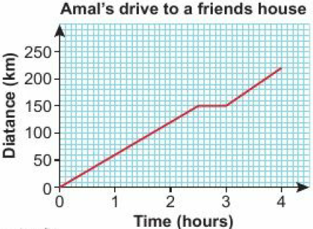
6.3 – Graphing Rates of Change
Page 645
a. 10 mm² b. 10.5cm²
a. 6km b. 5.45 pm c. 30 minutes d. 2 hrs 30 minutes e. 12 km/h f. 12
a. b. 60km/h

Slide 19
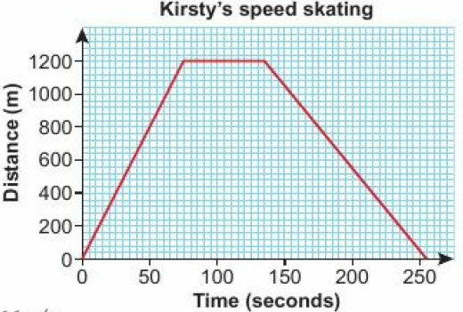
6.3 – Graphing Rates of Change
Page 645
a. b. 16m/s

Slide 20
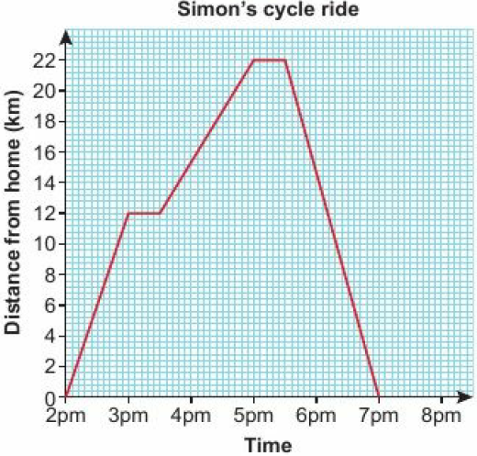
6.3 – Graphing Rates of Change
Page 645
a. 30 minutes b. 22km c.

Slide 21
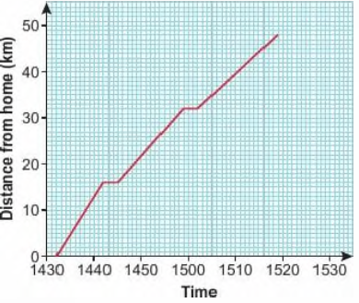
6.3 – Graphing Rates of Change
Page 645
a. Train journey from Birmingham to Shrewsbury
96mph c. 48mph d. 61.3mph

Slide 22
6.3 – Graphing Rates of Change
Page 646
55 km/h
a. 85 miles approximately b. 100 mph, 109 mph c. Between 3:00 and 3:40; the line is steeper d. Train A
a. C b. iii c. Aii, Bi, Ciii
Students' own sketches, showing B is steepest and A is the least steep.

Slide 23
6.3 – Graphing Rates of Change
Page 646
a. 1.6m/s b. 5 minutes c. 0.0092 m/s² d. 96 m
He accelerated at 0.0092 m/s² for the first 2 minutes, then ran at a constant velocity of 1.1 m/s for 5 minutes. Next, he accelerated at 0.0083 m/s² for 1 minute, then ran at a constant velocity of 1.6 m/s for 8 minutes. Then he decelerated at 0.013 m/s² for the last 2 minutes.

Slide 24
6.4 – Real-Life Graphs
Page 646
a.
i. £124 ii. £340 units

Slide 25
6.4 – Real-Life Graphs
Page 646
a. £1.00 b. £54 c. 149 pens
a. C$14 b. €0.7 c. 1.4
a. £24 per day b. £40 c. y = 24x + 40 d. 17 days
B and C
Question 3

Slide 26
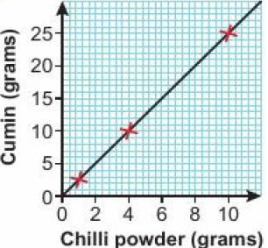
6.4 – Real-Life Graphs
Page 646
a. b. c. y = 2.5x d. 34g
Chilli powder (grams) | 1 | 4 | 10
Cumin (grams) | 2.5 | 10 | 25

Slide 27
6.4 – Real-Life Graphs
Page 646
a. The y-intercept tells you the initial temperature of the freezer. The x-intercept tells you at what time the temperature reaches 0⁰C b. 10°C c. 20°C d. Yes, because it is a straight line.

Slide 28
6.4 – Real-Life Graphs
Page 646
a. b. i. 16°C ii. 20°C
a = 5, b = 50
Yes, 4 teaspoons is much less than 500g

Slide 29
6.4 – Real-Life Graphs
Page 646
a. i. £18 ii. £14.50
This is the minimum monthly spend - you have to pay this even if you don't use the phone that month,
The point of intersection is where the two plans charge the same amount for the same number of minutes,
Molly – Plan C; Theo – Plan B

Slide 30
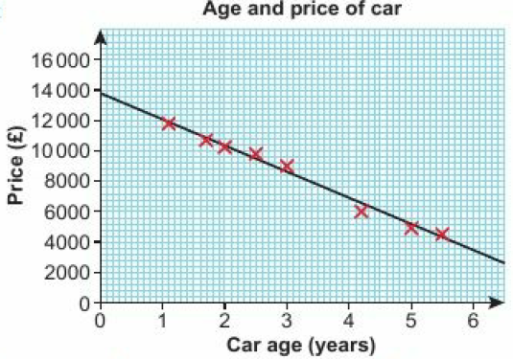
6.4 – Real-Life Graphs
Page 646
a. c.
Negative
y = -1600x + 13,600
£8,000
a. i. 84.6 ii. 91.4
84.6 in 2020, because 2020 is closer to the years covered by the data.

Slide 31
6.5 – Line Segments
Page 646
a. 7 b. 1
13 cm
Gradient: 2, y-intercept; -3
a. (2, 5) b. (5.5, 5.5)
a. (1.5, 5.5) b. (4,-1)
a. 3 b. -2
a. 5 b. 10

Slide 32
6.5 – Line Segments
Page 646
a. y = 2x + c b. y = x – 9
y = 15x + 180
y = $\frac{1}{3}$x – 5
y = 3x + 4
a. A₁:2, A₂:-$\frac{1}{2}$; B₁:3, B₂:-$\frac{1}{3}$; C₁:$\frac{1}{4}$, C₂:-4 b. The all equal -1
a. -$\frac{1}{3}$ b. 4 c. - $\frac{5}{2}$
a. y = -2x + 5 b. y = x - 4

Slide 33
6.6 – Quadratic Graphs
Page 646
Line A is y = -2 Line B is x = 5 Line C is x = -3 Line D is y = 0
x | -4 | -3 | -2 | -1 | 0 | 1 | 2 | 3 | 4
y | 16 | 9 | 4 | 1 | 0 | 1 | 4 | 9 | 16

Slide 34
6.6 – Quadratic Graphs
Page 647

Slide 35
6.6 – Quadratic Graphs
Page 647
a. b.
x | -3 | -2 | -1 | 0 | 1 | 2 | 3
x² | 9 | 4 | 1 | 0 | 1 | 4 | 9
-3 | -3 | -3 | -3 | -3 | -3 | -3 | -3
y | 6 | 1 | -2 | -3 | -2 | 1 | 6

Slide 36
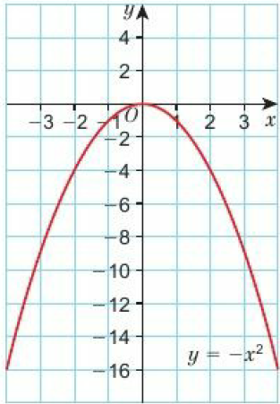
6.6 – Quadratic Graphs
Page 647

Slide 37
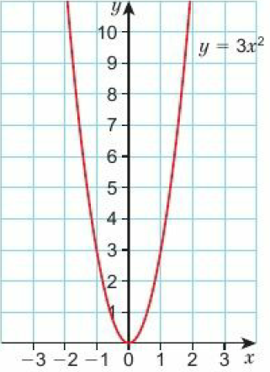
6.6 – Quadratic Graphs
Page 647
a. b.
x | -2 | -1 | 0 | 1 | 2
y | 12 | 3 | 0 | 3 | 12

Slide 38
6.6 – Quadratic Graphs
Page 647
a. Same parabola shape b. Q3, Q4 and Q6 have minimum Q5 has maximum. c. Q3: (0,0), Q4: (0,-3), Q5: (0,0), Q6: (0,0) d. x = 0 for all four graphs
a. Quadratic b. Between 3.6 and 5.2 seconds c. 2.6 seconds d. 32m e. 5.2 seconds
x = 1 or -1

Slide 39
6.6 – Quadratic Graphs
Page 647
a. x = 0 or 2 b. x = 1 c. x = -3 or 0.5 d. x = -3 or 2
a. x = -0.7 or 2.7 b. x = -1 or 3 c. x = -2.6 or 0.6 d. x = -3.3 or 0.3 e. The curve does not meet or cross the x-axis (or y = 0)

Slide 40
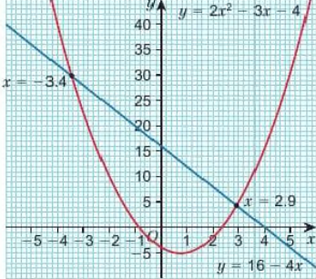
6.6 – Quadratic Graphs
Page 647
a. b. c. x = -3.4 or 2.9
x | -2 | -1 | 0 | 1 | 2 | 3 | 5
y | 10 | 1 | -4 | -5 | -2 | 5 | 16

Slide 41
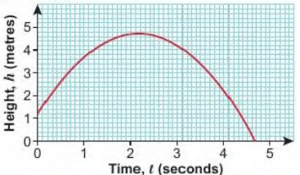
6.6 – Quadratic Graphs
Page 647
a. b. Around 4.65 seconds.

Slide 42
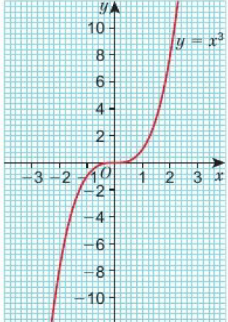
6.7 – Cubic & Reciprocal Graphs
Page 647
a. - $\frac{1}{2}$ b. 3
x | -3 | -2 | -1 | 0 | 1 | 2 | 3
y | -27 | -8 | -1 | 0 | 1 | 8 | 27

Slide 43
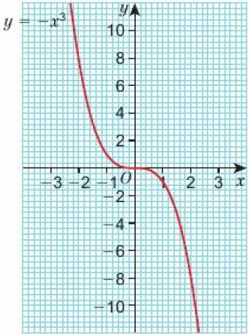
6.7 – Cubic & Reciprocal Graphs
Page 648
a. Students’ own estimate b. Students’ own estimate c. 4.91 d. -2.22

Slide 44
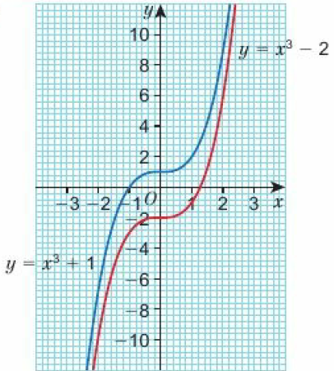
6.7 – Cubic & Reciprocal Graphs
Page 648
a. b. Students’ own estimate

Slide 45
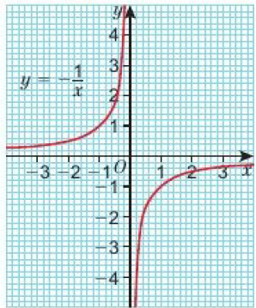
6.7 – Cubic & Reciprocal Graphs
Page 648
a. b.
Students’ own answers, e.g. The two graphs have the same shape but in different quadrants.
x | -3 | -2 | -1 | - $\frac{1}{2}$ | - $\frac{1}{4}$ | $$\frac{1}{4}$$ | $$\frac{1}{2}$$ | 1 | 1 | 3
y | $$\frac{1}{3}$$ | $$\frac{1}{2}$$ | 1 | 2 | 4 | -4 | -2 | -1 | - $\frac{1}{2}$ | - $\frac{1}{3}$

Slide 46
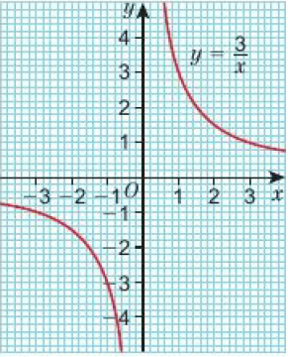
6.7 – Cubic & Reciprocal Graphs
Page 648
a. b. i. 1 ii. -3 iii. -1.2

Slide 47
6.7 – Cubic & Reciprocal Graphs
Page 648
a. E b. F c. B d. D e. C f. A
a. x = 1.3 b. x = -1 c. x = -1

Slide 48
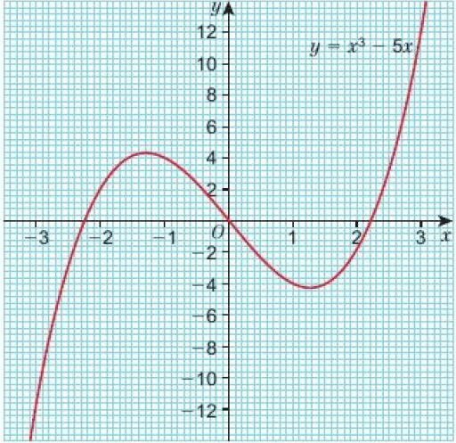
6.7 – Cubic & Reciprocal Graphs
Page 648
a. b. c. x = -2, -0.4 or 2.4
x | -3 | -2 | -1 | 0 | 1 | 2 | 3
y | -12 | 2 | 4 | 0 | -4 | 2 | 12

Slide 49
6.7 – Cubic & Reciprocal Graphs
Page 648
a. b. c. x = -2, -0.4 or 2.4
x | -3 | -2 | -1 | 0 | 1 | 2 | 3
y | -12 | 2 | 4 | 0 | -4 | 2 | 12

Slide 50
6.7 – Cubic & Reciprocal Graphs
Page 648
a. x = -1.3 or 0 or 1.7 b. x = -1.6 or 1

Slide 51
6.8 – More Graphs
Page 648
a. 3.5 b. 5.7
Students‘ circle with radius 5cm
a. 120 miles b. 3$\frac{1}{4}$ hours c. 70mph d. 2130 e. 37 mph f. The bus’s speed increasing.
2000m as this is when she starts to descend at a constant speed.

Slide 52
6.8 – More Graphs
Page 649
a.

Slide 53
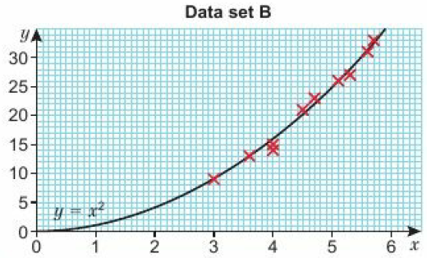
6.8 – More Graphs
Page 649
a.

Slide 54
6.8 – More Graphs
Page 649
b. Both graphs show strong positive correlation,
x is proportional to y
y = x² is very close to the line of best fit, so y is proportional to x².
x | 3.0 | 3.2 | 3.5 | 3.7 | 4.0
y | 9.00 | 10.24 | 12.25 | 13.69 | 16.00
x | 4.5 | 4.8 | 5.0 | 5.5 | 6.0
y | 20.25 | 23.04 | 25.00 | 30.25 | 36.00

Slide 55
6.8 – More Graphs
Page 649
a.
14.6 km/l
65 km/h and 100 km/h

Slide 56
6.8 – More Graphs
Page 649
a. 4 rats b. Found the y-intercept
i. 14 rats ii. 32 rats
The number of rats increased (at a faster rate)
a. 17 counts per second
15 minutes
9 minutes d. No
a. £1000 b. £1126
£24 d. 2.4% over the 5 years

Slide 57
6.8 – More Graphs
Page 649
a.

Slide 58
6 – Problem Solving
Page 649
Tom makes (T - 25) profit on each pair of trainers. His total profit will be this expression multiplied by the number of trainers he sells, Q.
When Tom sells his trainers at £40 then Q = 10(40 - 40) = 0. When he sells them at £39 then Q = 10(40 - 39) = 10 and this will increase by 10 for every £1 he lowers.
P = -10T² + 650T - 10000

Slide 59
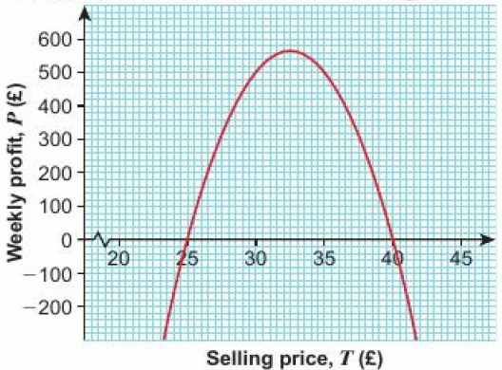
6 – Problem Solving
Page 649
One appropriate method would be to draw a graph. This one shows the optimum result is at £32.50m giving a profit of £562.50.
The new formula would be P = (400 – 10T)(T- 26) = -10T² + 660T- 10400. The new optimum result is at £33, giving a profit of £490.

Slide 60
6 – Check-Up
Page 649
Gradient: - $\frac{1}{2}$, y-intercept: $\frac{7}{3}$
A: 2x + 3, B: 3x + 2, C: -2x + 3, D: 5x + 5

Slide 61
6 – Check-Up
Page 650
a. - $\frac{1}{2}$ b. 3
a. 12, Hamzah is cycling at 12 mph b. 14.7 mph
2.75 to 3 hours (or final 15 minutes)
40 mph
a. Price per cupcake
Minimum price c. No
a. (-0.5, -3) b. 6.4
a. y = 3x - 13
Any equation with y = - $\frac{1}{3}$x plus a constant, e.g. y = - $\frac{1}{3}$x + 8

Slide 62
6 – Check-Up
Page 650
a. A b. E c. B d. G e. C f. F g. D
x = -1.5, -0.4, 1.9
a. (0.75,2) b. 2m c. 2.1 seconds
The height that the water comes out of the hosepipe.
a. D b. A c. C d. B
Students‘ own answers

Slide 63
6 – Strengthen
Page 650
Linear graphs
a. i, iv
ii. y = 2x + 3 iii. y = -x + 4 v. y = -5x + $\frac{1}{2}$
a. B and C b. C and D
A and B
i. D ii. B iii. C iv. A
a. B b. C c. A

Slide 64
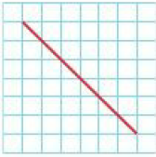
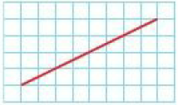
6 – Strengthen
Page 650
a. e.g. b. e.g. c. e.g.

Slide 65
6 – Strengthen
Page 650
a, b, c

Slide 66
6 – Strengthen
Page 650
a. 5 b. 5 c. 1
a. $\frac{2}{3}$ b. $\frac{5}{4}$
$\sqrt{13}$, $\sqrt{41}$
(-0.5, 4), (-2, 1.5)
a. A and F, B and D
y = 2x plus a constant e.g. y = 2x – 8, y = -x plus a constant e.g. y = -x +- 5

Slide 67
6 – Strengthen
Page 650
a. - $\frac{1}{4}$ b. -3 c. $\frac{1}{10}$ d. $\frac{5}{3}$
A and B, C and F, D and E
a. L and P
No, only points L and P satisfy the equation.
a. 3 b. y = 3x + 10

Slide 68
6 – Strengthen
Page 650
Non-Linear graphs
a. (0, 0), (-5, 23), (-2, 7), (3, 10)
a. (3, -26) b. (-2, -7), (3, -26) c. (-2, -9), (3, 26)
a. A:y = x² + 1, F:y = -x² + 4
B:y = x³ - 2, E:y = -x³
C:y = $\frac{1}{x}$ d. D:y = x - 2

Slide 69
6 – Strengthen
Page 650
Real-Life graphs
a. Quadratic b. (0,5) c. 4.6m d. 3.5m and-3.5m e. Distance in front of the goal posts f. 5 m g. Yes
a. The water level in Vase 1 rises faster first, then slower. The water in Vase 2 rises slower first, then faster,
Vase 1 - Graph B; Vase 2 - Graph A
a. i. £1.25 ii. 260 iii. £8.75 iv. 95 (or 96)
They are in direct proportion

Slide 70
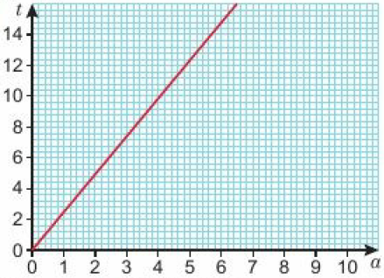
6 – Extend
Page 650
a. C and D b. A and C
a. (3, 3.5) b. - $\frac{6}{5}$
a. (11,13) b. $\frac{4}{3}$
Number of seeds = -17 x seed size + 49
a. 2t = 5a b.
2.5
240 aubergines.

Slide 71
6 – Extend
Page 650
a. C b. A c. B
a. x² – 3x – 2x – 1 + 1 = x² - 5x = 0
y = 2x - 1
x = 0, 5

Slide 72
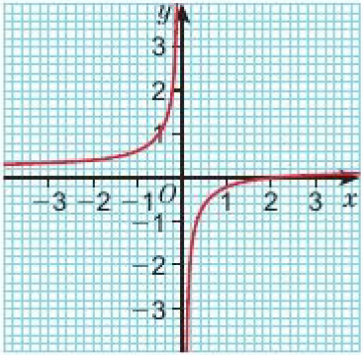
6 – Extend
Page 650
a.
x = 0 and y = 1
x | -3 | -2 | -1 | -0.5 | -0.1 | 0.1 | 0.5 | 1 | 2 | 3
y | 1.7 | 2 | 3 | 5 | 21 | -19 | -3 | -1 | 0 | 0.3

Slide 73
6 – Extend
Page 650
a. graph plotted with points at (0, 0), (1, 0.6), (2, 2.4), (2, 2.4), (3, 5.4), (4, 9.6), (5, 15), (6, 21.6), (7, 29.4), (8, 38.4), (9, 48.6), (10, 60)
12.2 m c. 8.2 seconds
a. 3x + 5y = c where c ≠ -10 (or y = - $\frac{3}{5}$x +c where c ≠ - 2)
2y – 4x = 2 (or y = 2x + 1)
y = $\frac{3}{4}$x + 2.5 (or 4y = 3x + 10)

Slide 74
6 – Extend
Page 650
a. y = -0.5x - 2 b. (-2, -1) c. 5.8
k = 7; D = (4, 7); point (4, 7) satisfies the equation y = 2x - 1
PD = 7.5
a. i. C ii. D iii. A iv. B
A:x = 0, B: no line symmetry, C:x = 0, D: y = x
a. A b. B c. C d. D

Slide 75
6 – Unit Test
Page 650
Sample student answers
Students' own answers

